Slide 1


INSTITUTE: UIE (AIT-CSE)
Computer Networks CST- 348
Lecture - 1 .5
Hub,Switch and Router
By : Dr. Monica Luthra(e9836)
DISCOVER . LEARN . EMPOWER

Slide 2

Course Objectives
CO Number | Title
CO1 | Describe the important networking concepts
CO2 | Understand concept of network reference models and protocols
CO3 | Apply the concepts of routing algorithms on various networks
CO4 | Identify mechanism to handle traffic and control on congestion
CO5 | Identify and understand connection establishment techniques and features

Slide 3

Course Outcomes
After this course student will be able to:
To bring together several key of Computer network design and architecture
To Familiarize the student with the basic taxonomy and terminology of the computer networking area.
To Allow the student to gain expertise in some specific areas of networking such as the design and maintenance of individual networks.

Slide 4

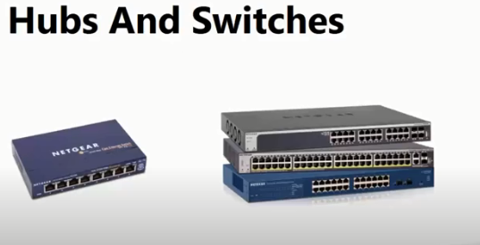
HUBS,SWITCHES,ROUTERS
DIFFERENCE

Slide 5
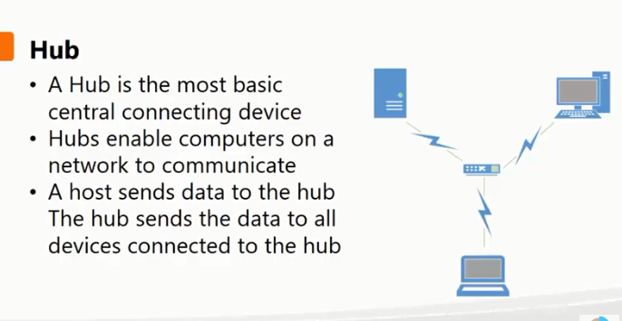
Hub-BROADCAST

Slide 6
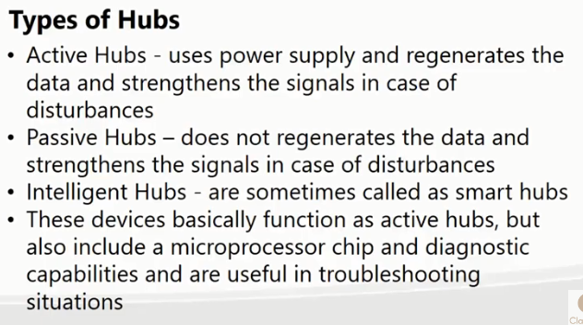
Hub-BROADCAST

Slide 7
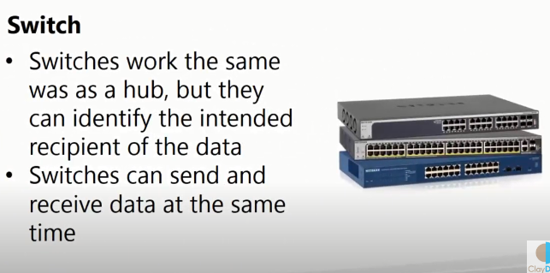
SWITCHES

Slide 8
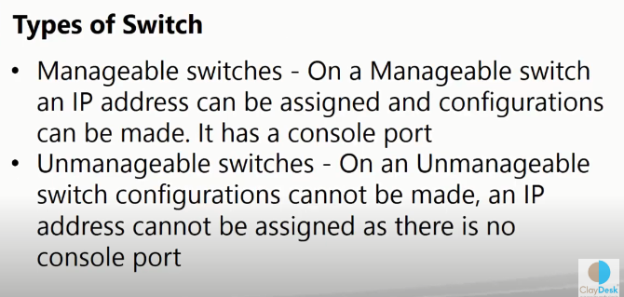
TYPES OF SWITCH

Slide 9
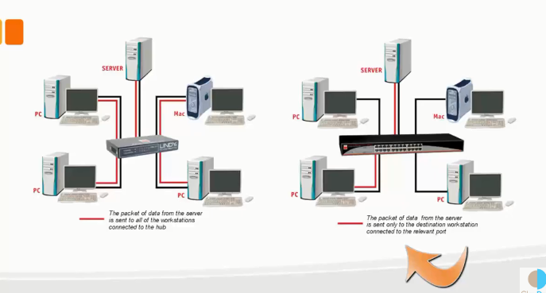
WORKING MODEL OF SWITCH AND HUB

Slide 10
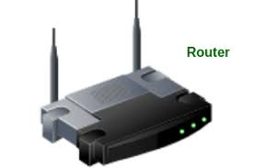
ROUTER
A Router is a networking device that forwards data packets between computer network.
Routers perform the traffic directing functions on the Internet.
Data sent through the internet, such as a web page or email, is in the form of data packets.
A packet is typically forwarded from one router to another router through the networks that constitute an internetwork (e.g. the Internet) until it reaches its destination node

Slide 11
ROUTER
SCENARIO
suppose you search for www.google.com in your web browser then this will be a request which will be sent from your system to the google`s server to serve that webpage, now your request which is nothing but a stream of packets don`t just go the google`s server straightaway they go through a series of networking devices known as router which accepts this packets and forwards them to correct path and hence it reaches to the destination server.

Slide 12
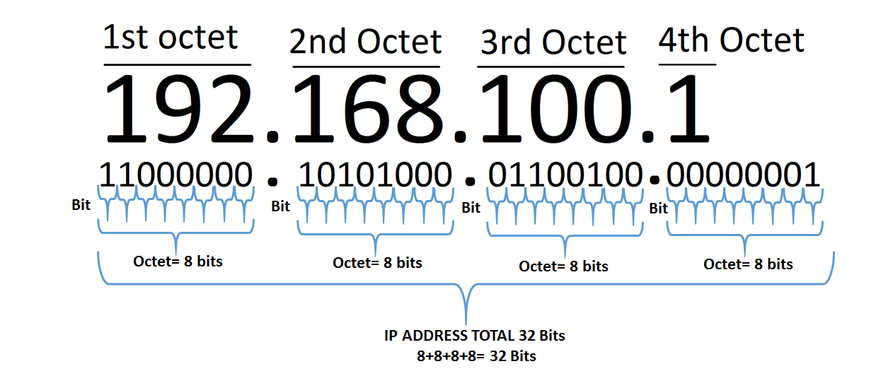
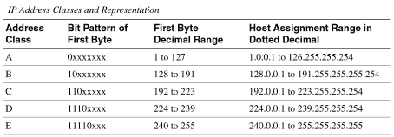
IPv4 Addressing
Image Source : https://en.wikipedia.org/wiki/IPv6

Slide 13
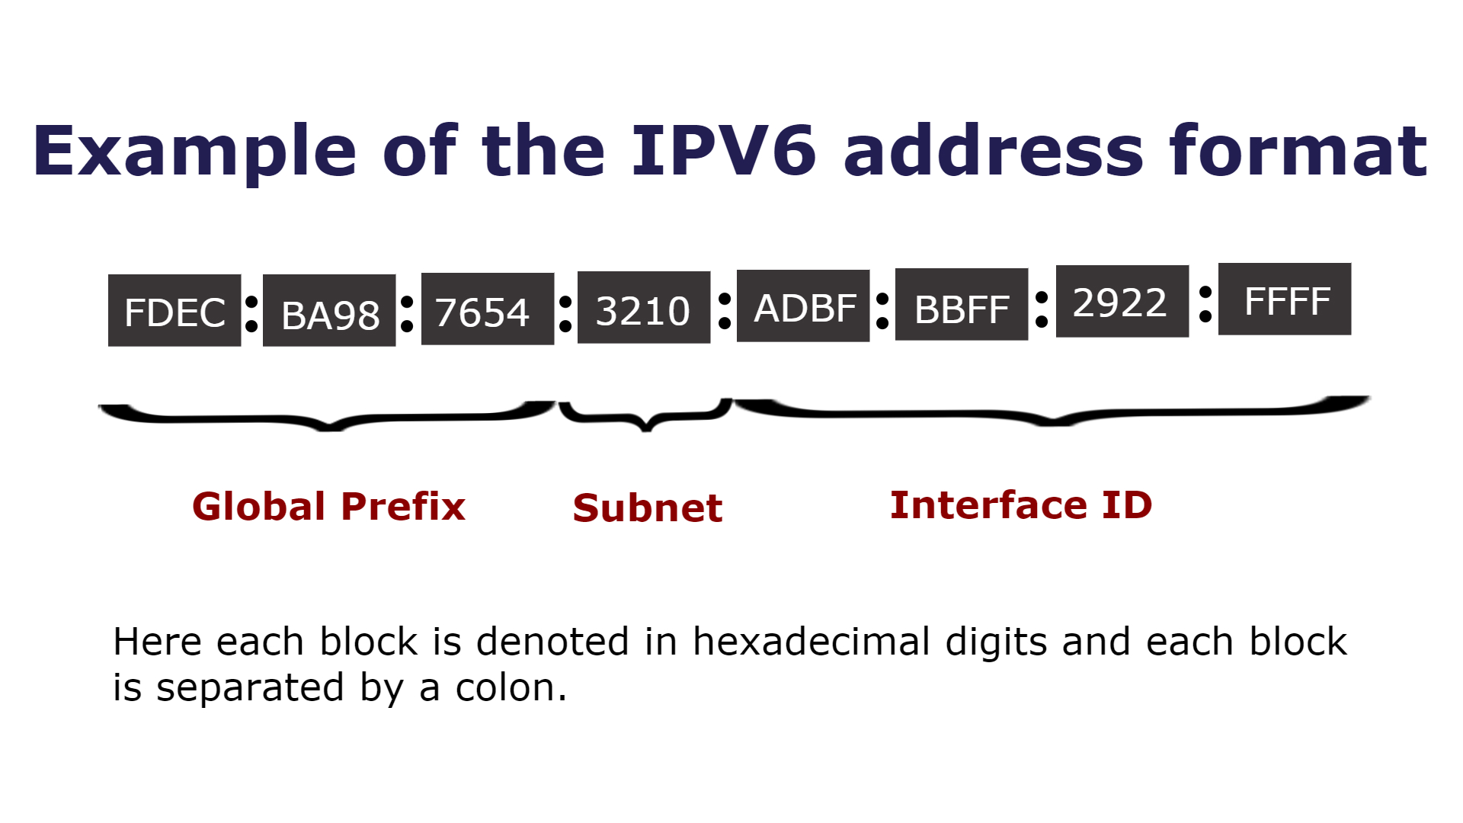
IPv6 Addressing
In IPv6, the address size was increased from 32 bits in IPv4 to 128 bits, thus providing up to 2¹²⁸ (approximately 3.403×10³⁸) addresses. This is deemed sufficient for the foreseeable future.
Image Source : https://en.wikipedia.org/wiki/IPv6

Slide 14
Key Points
Data communications are the transfer of data from one device to another via some form of transmission medium.
A data communications system must transmit data to the correct destination in an
accurate and timely manner.
Text, numbers, images, audio, and video are different forms of information.
Data flow between two devices can occur in one of three ways: simplex, half-duplex, or full-duplex.
In a point-to-point connection, two and only two devices are connected by a
dedicated link. In a multipoint connection, three or more devices share a link.
Topology refers to the physical or logical arrangement of a network. Devices may be arranged in a mesh, star, bus, or ring topology.
A network can be categorized as a local area network or a wide area network.
There are local, regional, national, and international Internet service providers.
A protocol is a set of rules that govern data communication; the key elements of a protocol are syntax, semantics, and timing

Slide 15
References
https://www.geeksforgeeks.org/basics-computer-networking/
https://www.youtube.com/watch?v=VwN91x5i25g&list=PLBlnK6fEyqRgMCUAG0XRw78UA8qnv6jEx
http://www.svecw.edu.in/Docs%5CCSECNLNotes2013.pdf
https://www.cloudflare.com/learning/ddos/glossary/open-systems-interconnection-model-osi/

Slide 16

THANK YOU
For queries
Email: monica.e9836@cumail.in

